Slide 1
Chapter 10: Mass-Storage Systems

Slide 2
Chapter 10: Mass-Storage Systems
Overview of Mass Storage Structure
Disk Structure
Disk Attachment
Disk Scheduling
Disk Management
Swap-Space Management
RAID Structure
Stable-Storage Implementation

Slide 3
Objectives
To describe the physical structure of secondary storage devices and its effects on the uses of the devices
To explain the performance characteristics of mass-storage devices
To evaluate disk scheduling algorithms
To discuss operating-system services provided for mass storage, including RAID

Slide 4
Overview of Mass Storage Structure
Magnetic disks provide bulk of secondary storage of modern computers
  Drives rotate at 60 to 250 times per second
  Transfer rate is rate at which data flow between drive and computer
  Positioning time (random-access time) is time to move disk arm to desired cylinder (seek time) and time for desired sector to rotate under the disk head (rotational latency)
  Head crash results from disk head making contact with the disk surface -- That’s bad
Disks can be removable
Drive attached to computer via I/O bus
  Buses vary, including advanced technology attachment (ATA), SATA, USB, Fiber Channel, small computer–systems interface (SCSI), etc
  Host controller in computer uses bus to talk to disk controller built into drive or storage array

Slide 5

Moving-head Disk Mechanism

Slide 6

Hard Disks
Platters range from .85” to 14” (historically)
  Commonly 3.5”, 2.5”, and 1.8”
Range from 30GB to 3TB per drive
Performance
  Transfer Rate – theoretical – 6 Gb/sec
  Effective Transfer Rate – real – 1Gb/sec
  Seek time from 3ms to 12ms – 9ms common for desktop drives
  Average seek time measured or calculated based on 1/3 of tracks
  Latency based on spindle speed
    1 / (RPM / 60) = 60 / RPM
  Average latency = ½ latency
(From Wikipedia)

Slide 7
Hard Disk Performance
Average access time = average seek time + average latency
  For fastest disk 3ms + 2ms = 5ms
  For slow disk 9ms + 5.56ms = 14.56ms
Average I/O time = average access time + (amount to transfer / transfer rate) + controller overhead
For example to transfer a 4KB block on a 7200 RPM disk with a 5ms average seek time, 1Gb/sec transfer rate with a .1ms controller overhead =
  Average I/O time=5ms + 4.17ms + 0.1ms + transfer time
  Transfer time = 4KB / 1Gb/s * 8Gb / GB * 1GB / 1024²KB = 32 / (1024²) = 0.031 ms
  Average I/O time for 4KB block = 9.27ms + .031ms = 9.301ms

Slide 8

The First Commercial Disk Drive
1956
IBM RAMDAC computer included the IBM Model 350 disk storage system
5M (7 bit) characters
50 x 24” platters
Access time = < 1 second

Slide 9
Solid-State Disks
Nonvolatile memory used like a hard drive
  Many technology variations
Can be more reliable than HDDs
More expensive per MB
Maybe have shorter life span
Less capacity
But much faster
Busses can be too slow -> connect directly to PCI for example
No moving parts, so no seek time or rotational latency

Slide 10
Magnetic Tape
Was early secondary-storage medium
Relatively permanent and holds large quantities of data
Access time slow
Random access ~1000 times slower than disk
Mainly used for backup, storage of infrequently-used data, transfer medium between systems
Kept in spool and wound or rewound past read-write head
Once data under head, transfer rates comparable to disk
  140MB/sec and greater
200GB to 1.5TB typical storage
Common technologies are LTO-{3,4,5} and T10000

Slide 11
Disk Structure
Disk drives are addressed as large 1-dimensional arrays of logical blocks, where the logical block is the smallest unit of transfer
  Low-level formatting creates logical blocks on physical media
The 1-dimensional array of logical blocks is mapped into the sectors of the disk sequentially
  Sector 0 is the first sector of the first track on the outermost cylinder
  Mapping proceeds in order through that track, then the rest of the tracks in that cylinder, and then through the rest of the cylinders from outermost to innermost
  Logical to physical address should be easy
    Except for bad sectors
    Non-constant # of sectors per track via constant angular velocity

Slide 12
Disk Attachment
Computers access disk storage into two ways
  Host-attached storage accessed through I/O ports
  Network-attached storage (through a remote host)

Slide 13

Network-Attached Storage
Network-attached storage (NAS) is storage made available over a network rather than over a local connection (such as a bus)
  Remotely attaching to file systems
NFS and CIFS are common protocols
Implemented via remote procedure calls (RPCs) between host and storage over typically TCP, or UDP, or IP network
Increases the latency of network communication

Slide 14

Storage Area Network
Common in large storage environments
Multiple hosts attached to multiple storage arrays - flexible

Slide 15
Disk Scheduling
The operating system is responsible for using hardware efficiently — for the disk drives, this means having a fast access time and disk bandwidth
Minimize seek time
Seek time is the time for the disk arm to move the heads to the cylinder containing the desired sector
The rotational latency is the additional time for the disk to rotate the desired sector to the disk head
Disk bandwidth is the total number of bytes transferred, divided by the total time between the first request for service and the completion of the last transfer

Slide 16
Disk Scheduling (Cont.)
There are many sources of disk I/O request
  OS
  System processes
  Users processes
I/O request includes input or output mode, disk address, memory address, number of sectors to transfer
OS maintains queue of requests, per disk or device
Idle disk can immediately work on I/O request, busy disk means work must queue
  Optimization algorithms only make sense when a queue exists

Slide 17
Disk Scheduling (Cont.)
Note that drive controllers have small buffers and can manage a queue of I/O requests (of varying “depth”)
Several algorithms exist to schedule the servicing of disk I/O requests
The analysis is true for one or many platters
We illustrate scheduling algorithms with a request queue (0-199)
98, 183, 37, 122, 14, 124, 65, 67
Head pointer 53

Slide 18

FCFS
Illustration shows total head movement of 640 cylinders

Slide 19

SSTF
Shortest Seek Time First selects the request with the minimum seek time from the current head position
SSTF scheduling is a form of SJF scheduling; may cause starvation of some requests
Illustration shows total head movement of 236 cylinders

Slide 20
SCAN
The disk arm starts at one end of the disk, and moves toward the other end, servicing requests until it gets to the other end of the disk, where the head movement is reversed and servicing continues.
SCAN algorithm Sometimes called the elevator algorithm
Illustration shows total head movement of 208 cylinders
But note that if requests are uniformly dense, largest density at other end of disk and those wait the longest
Lower variance, but discriminates against outer and innermost tracks

Slide 21

SCAN (Cont.)

Slide 22
C-SCAN
Provides a more uniform wait time than SCAN
The head moves from one end of the disk to the other, servicing requests as it goes
  When it reaches the other end, however, it immediately returns to the beginning of the disk, without servicing any requests on the return trip
Treats the cylinders as a circular list that wraps around from the last cylinder to the first one
Total number of cylinders?

Slide 23

C-SCAN (Cont.)

Slide 24
C-LOOK
LOOK a version of SCAN, C-LOOK a version of C-SCAN
Arm only goes as far as the last request in each direction, then reverses direction immediately, without first going all the way to the end of the disk
Total number of cylinders?

Slide 25

C-LOOK (Cont.)

Slide 26
Selecting a Disk-Scheduling Algorithm
SSTF is common and has a natural appeal
SCAN and C-SCAN perform better for systems that place a heavy load on the disk
  Less starvation
Performance depends on the number and types of requests
Requests for disk service can be influenced by the file-allocation method
  And metadata layout
The disk-scheduling algorithm should be written as a separate module of the operating system, allowing it to be replaced with a different algorithm if necessary
Either SSTF or LOOK is a reasonable choice for the default algorithm
What about rotational latency?
  Difficult for OS to calculate

Slide 27
Disk Management
Low-level formatting, or physical formatting — Dividing a disk into sectors that the disk controller can read and write
  Each sector can hold header information, plus data, plus error correction code (ECC)
  Usually 512 bytes of data but can be selectable
To use a disk to hold files, the operating system still needs to record its own data structures on the disk
  Partition the disk into one or more groups of cylinders, each treated as a logical disk
  Logical formatting or “making a file system”
  To increase efficiency most file systems group blocks into clusters
    Disk I/O done in blocks
    File I/O done in clusters

Slide 28
Bad Blocks
Methods used to handle bad blocks
  sector sparing or forwarding
  sector slipping

Slide 29
RAID Structure
RAID – redundant array of inexpensive disks
  multiple disk drives provides reliability via redundancy
Increases the mean time to failure
Mean time to repair – exposure time when another failure could cause data loss
Mean time to data loss based on above factors
If mirrored disks fail independently, consider disk with 1300,000 mean time to failure and 10 hour mean time to repair
  Mean time to data loss is 100, 000² / (2 ∗ 10) = 500 ∗ 10⁶ hours, or 57,000 years!
Several improvements in disk-use techniques involve the use of multiple disks working cooperatively

Slide 30
RAID
RAID – redundant array of inexpensive disks
  multiple disk drives provides reliability via redundancy
Several improvements in disk-use techniques involve the use of multiple disks working cooperatively
Disk striping uses a group of disks as one storage unit
RAID is arranged into six different levels
RAID schemes improve performance and improve the reliability of the storage system by storing redundant data
  Mirroring or shadowing (RAID 1) keeps duplicate of each disk
  Striped mirrors (RAID 1+0) or mirrored stripes (RAID 0+1) provides high performance and high reliability
  Block interleaved parity (RAID 4, 5, 6) uses much less redundancy

Slide 31

RAID Levels

Slide 32
Extensions
RAID alone does not prevent or detect data corruption or other errors, just disk failures
Solaris ZFS adds checksums of all data and metadata
Checksums kept with pointer to object, to detect if object is the right one and whether it changed
Can detect and correct data and metadata corruption
ZFS also removes volumes, partitions
  Disks allocated in pools
  Filesystems with a pool share that pool, use and release space like malloc() and free() memory allocate / release calls

Slide 33
Stable-Storage Implementation
Write-ahead log scheme requires stable storage
Stable storage means data is never lost (due to failure, etc)
To implement stable storage:
  Replicate information on more than one nonvolatile storage media with independent failure modes
  Update information in a controlled manner to ensure that we can recover the stable data after any failure during data transfer or recovery
Disk write has 1 of 3 outcomes
  Successful completion - The data were written correctly on disk
  Partial failure - A failure occurred in the midst of transfer, so only some of the sectors were written with the new data, and the sector being written during the failure may have been corrupted
  Total failure - The failure occurred before the disk write started, so the previous data values on the disk remain intact

Slide 34
Stable-Storage Implementation (Cont.)
If failure occurs during block write, recovery procedure restores block to consistent state
  System maintains 2 physical blocks per logical block and does the following:
    Write to 1st physical
    When successful, write to 2nd physical
    Declare complete only after second write completes successfully

Slide 35
Tertiary Storage Devices
Low cost is the defining characteristic of tertiary storage
Generally, tertiary storage is built using removable media
Common examples of removable media are floppy disks and CD-ROMs; other types are available

Slide 36
Removable Disks
Floppy disk — thin flexible disk coated with magnetic material, enclosed in a protective plastic case
  Most floppies hold about 1 MB; similar technology is used for removable disks that hold more than 1 GB
  Removable magnetic disks can be nearly as fast as hard disks, but they are at a greater risk of damage from exposure

Slide 37
Removable Disks
A magneto-optic disk records data on a rigid platter coated with magnetic material
  Laser heat is used to amplify a large, weak magnetic field to record a bit
  Laser light is also used to read data (Kerr effect)
  The magneto-optic head flies much farther from the disk surface than a magnetic disk head, and the magnetic material is covered with a protective layer of plastic or glass; resistant to head crashes
Optical disks do not use magnetism; they employ special materials that are altered by laser light

Slide 38
WORM Disks
The data on read-write disks can be modified over and over
WORM (“Write Once, Read Many Times”) disks can be written only once
To write a bit, the drive uses a laser light to burn a small hole through the aluminum; information can be destroyed by not altered
Very durable and reliable
Read-only disks, such ad CD-ROM and DVD, come from the factory with the data pre-recorded

Slide 39
Tapes
Compared to a disk, a tape is less expensive and holds more data, but random access is much slower.
Tape is an economical medium for purposes that do not require fast random access, e.g., backup copies of disk data, holding huge volumes of data.

Slide 40
Speed
Two aspects of speed in tertiary storage are bandwidth and latency.
Bandwidth is measured in bytes per second.
  Sustained bandwidth – average data rate during a large transfer; # of bytes/transfer time
  Effective bandwidth – average over the entire I/O time, including seek() or locate()

Slide 41
Speed (Cont.)
Access latency – amount of time needed to locate data
  Access time for a disk – move the arm to the selected cylinder and wait for the rotational latency; < 35 milliseconds
  Access on tape requires winding the tape reels until the selected block reaches the tape head; tens or hundreds of seconds
  Generally say that random access within a tape cartridge is about a thousand times slower than random access on disk

Slide 42
Reliability
A fixed disk drive is likely to be more reliable than a removable disk or tape drive
An optical cartridge is likely to be more reliable than a magnetic disk or tape
A head crash in a fixed hard disk generally destroys the data, whereas the failure of a tape drive or optical disk drive often leaves the data cartridge unharmed

Slide 43
Cost
Main memory is much more expensive than disk storage
The cost per megabyte of hard disk storage is competitive with magnetic tape if only one tape is used per drive
The cheapest tape drives and the cheapest disk drives have had about the same storage capacity over the years
Tertiary storage gives a cost savings only when the number of cartridges is considerably larger than the number of drives

Slide 44
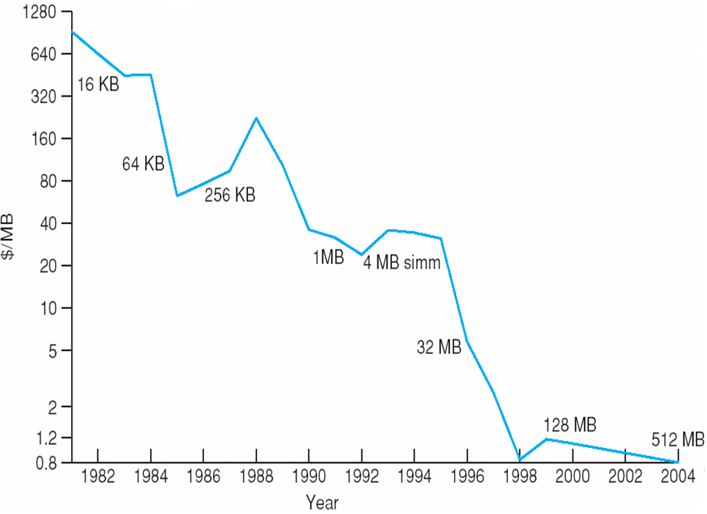
Price per Megabyte of DRAM
From 1981 to 2004

Slide 45
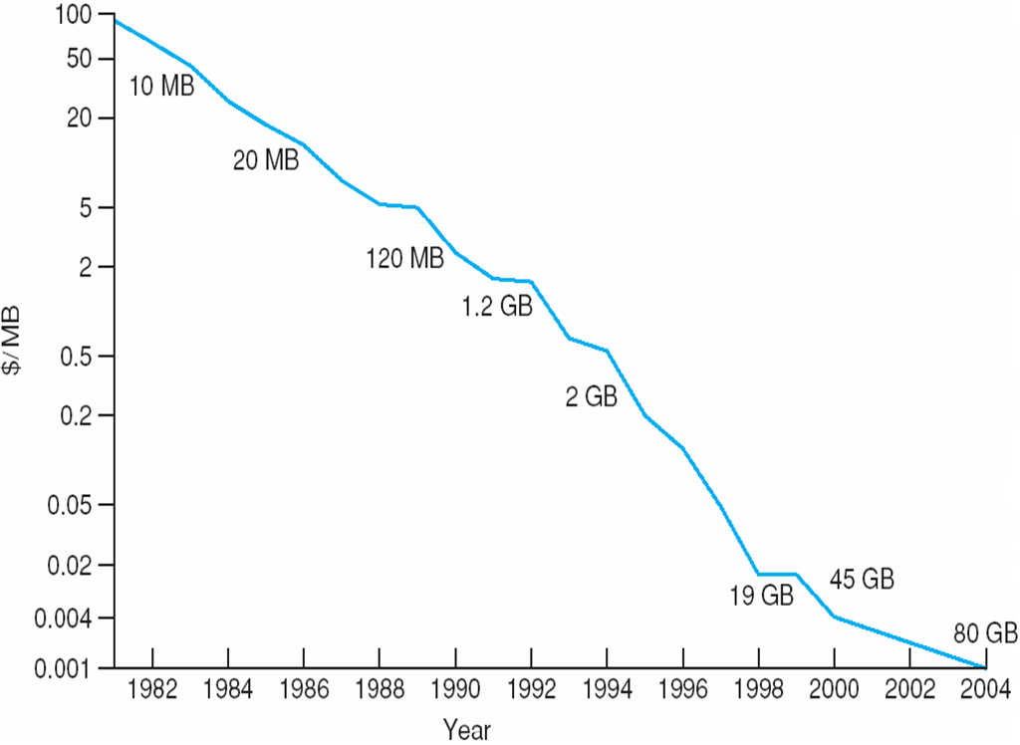
Price per Megabyte of Magnetic Hard Disk
From 1981 to 2004

Slide 46
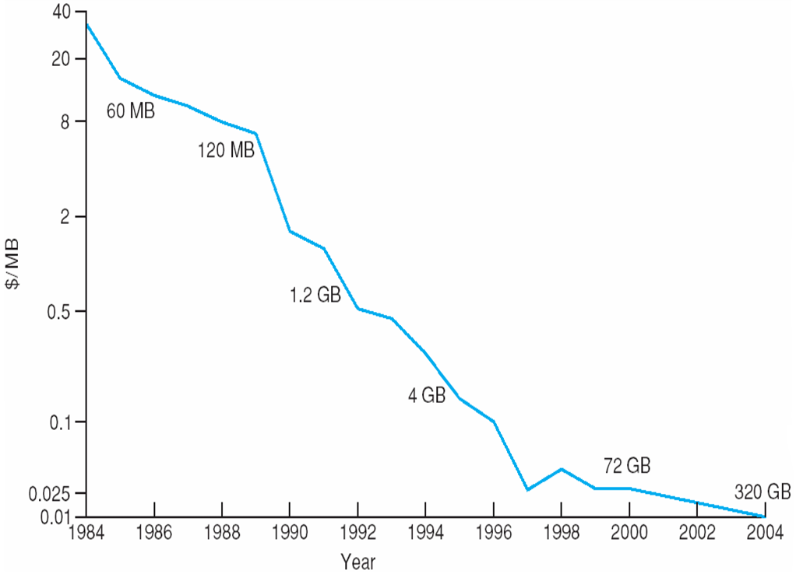
Price per Megabyte of a Tape Drive
From 1984-2000

Slide 47
End of Chapter 10

